Slide 1
Project ATLAS
11/05/2019

Slide 2
Project ATLAS: Improving Program Delivery at NCDOT
What is Project ATLAS?
A
T
L
A
S
Advancing
Transportation through
Linkages
Automation and
Screening
Project ATLAS is an effort to increase efficiency of Transportation Program Delivery.

Slide 3
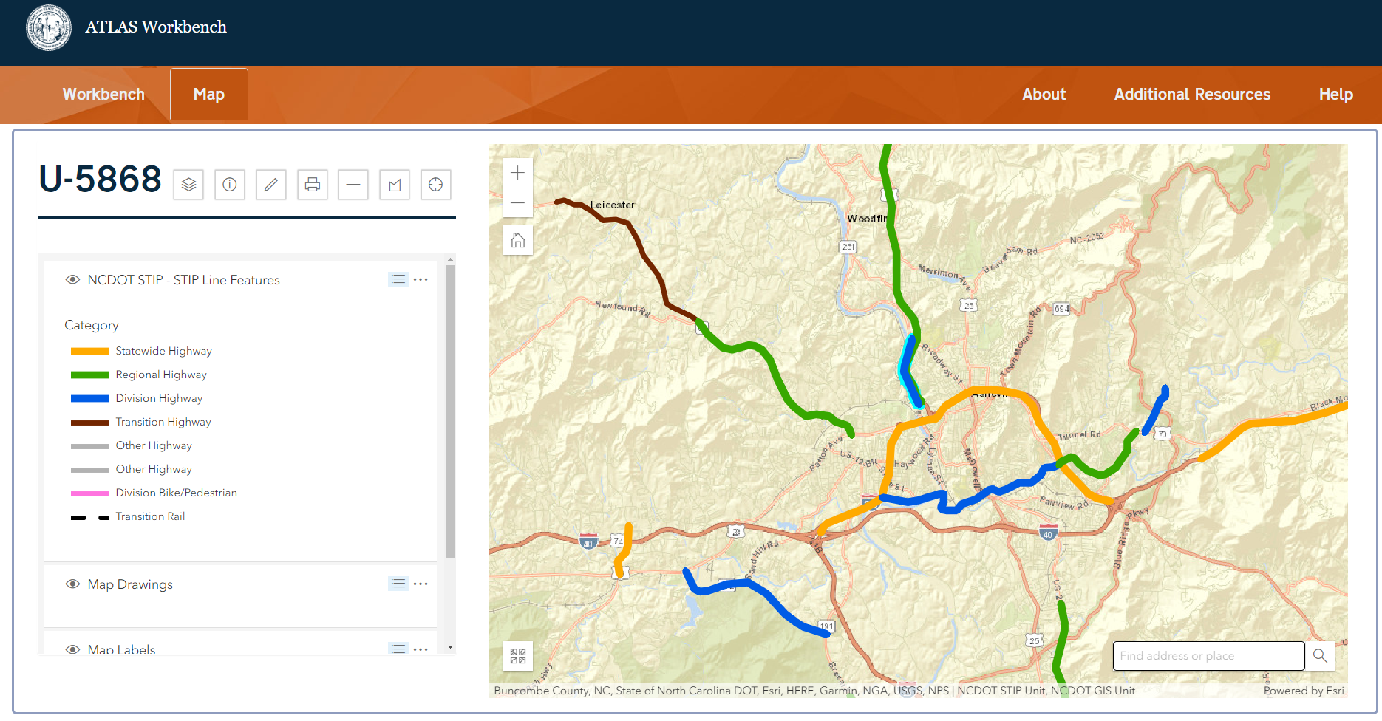
Project ATLAS: Improving Program Delivery at NCDOT
ATLAS Applications
SEARCH TOOL
Search or download data related to project development
Your Project
SCREENING TOOL
Screen projects for effects and create screening reports
APP
MANAGEMENT TOOL
Configuration tools in the hands of DOT Business
WORKBENCH
Manage and upload project data and deliverables, track project progress, and report on activities

Slide 4
Project ATLAS: Improving Program Delivery at NCDOT
ATLAS Search Tool
What the tool does for you:
Review and download data from multiple sources at once
Establish consistency on data sources being used across project teams for the same deliverables and decisions
Data from 600+ layers are projected and clipped to your study area

Slide 5
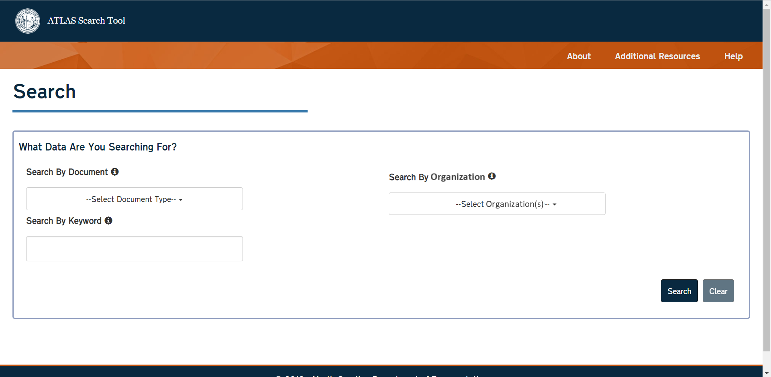
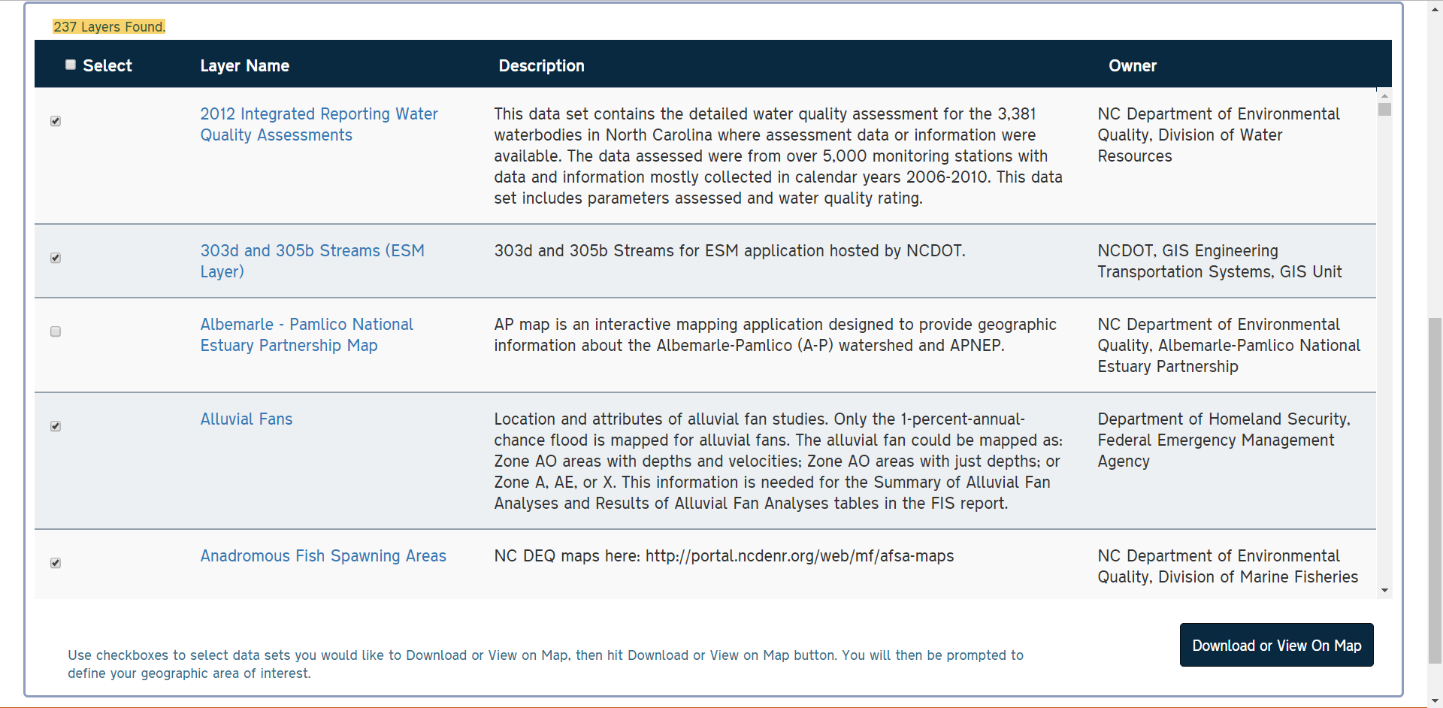
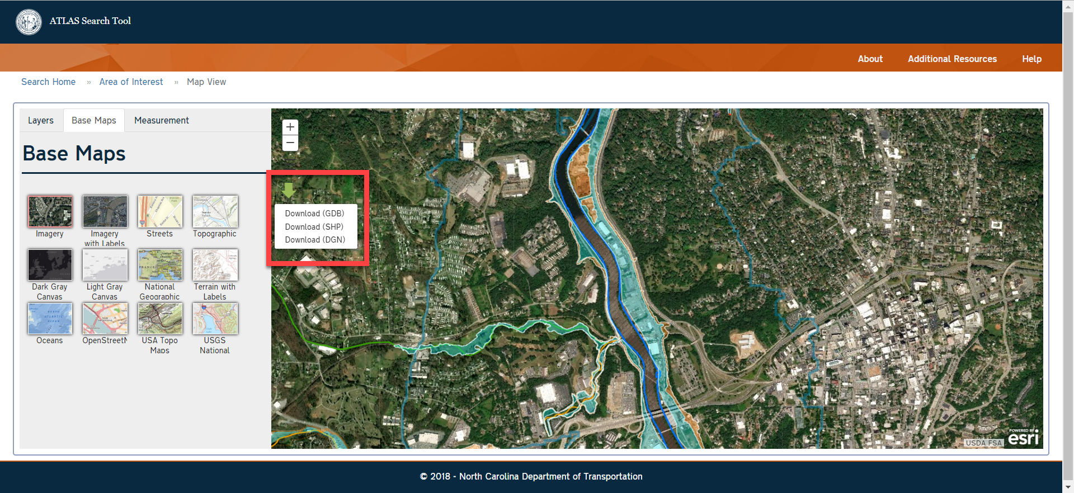
Project ATLAS: Improving Program Delivery at NCDOT
ATLAS Search Tool

Slide 6
Project ATLAS: Improving Program Delivery at NCDOT
ATLAS Screening Tool
What the tool does for you:
Provides high-level summary report on key environmental layers/features in your study area
Downloads of GIS datasets with features in your study area

Slide 7
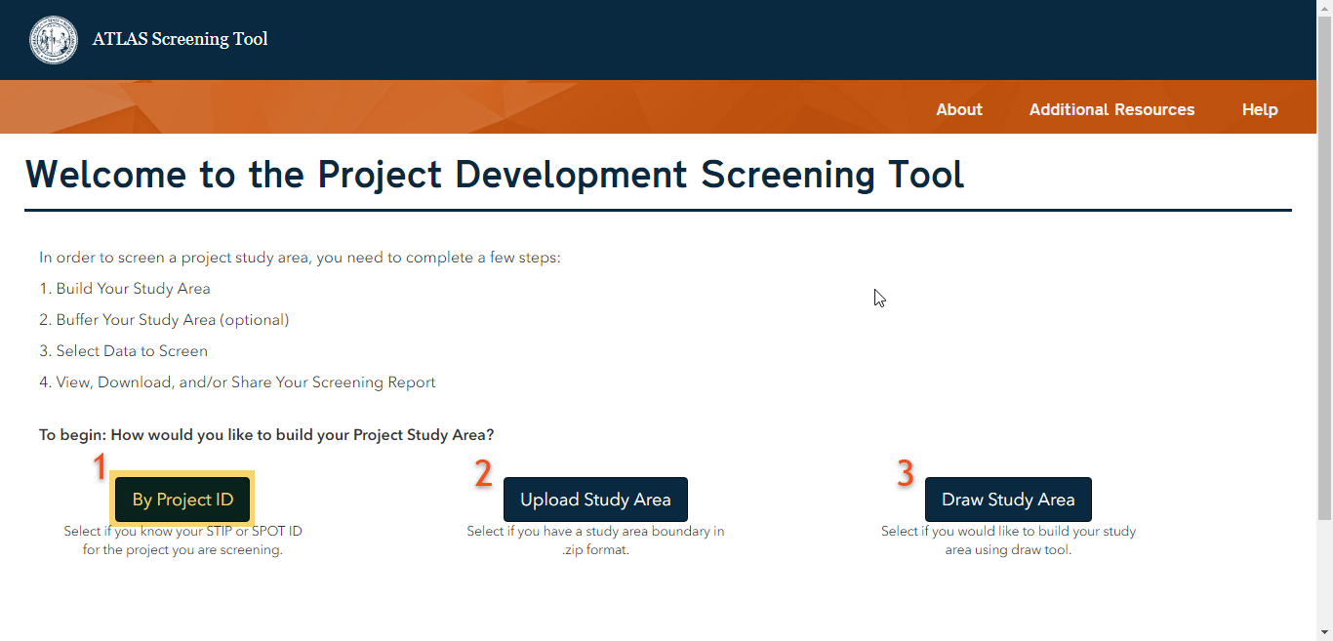
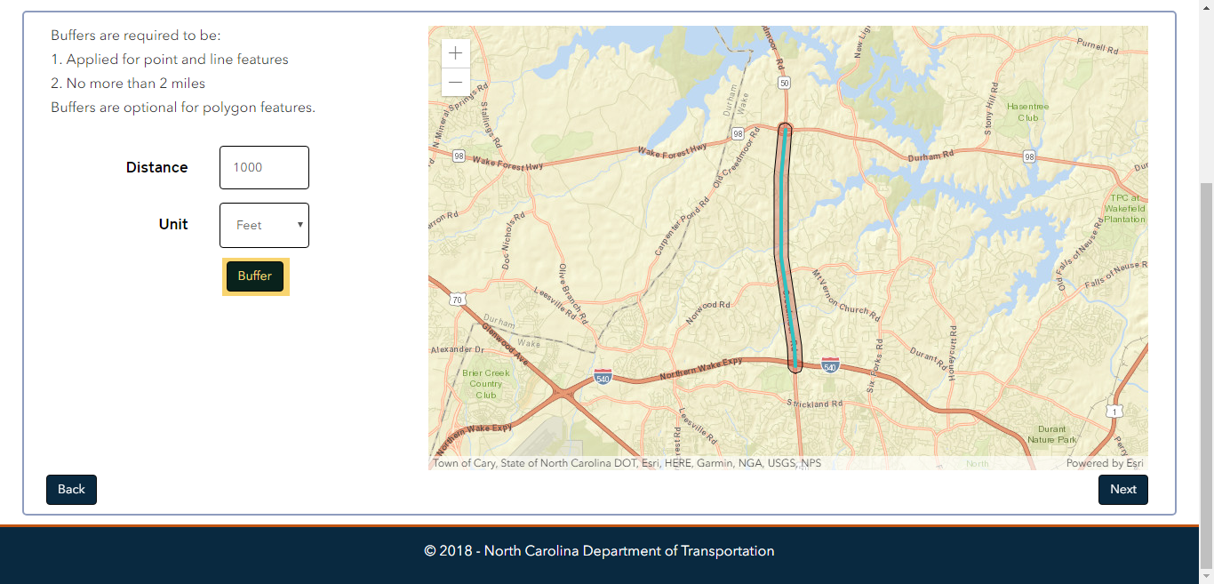
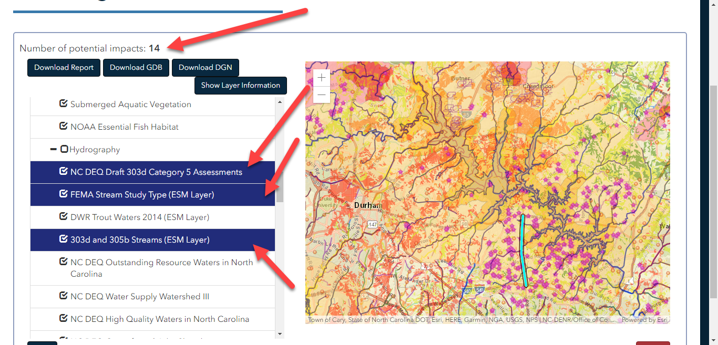
Project ATLAS: Improving Program Delivery at NCDOT
ATLAS Screening Tool

Slide 8
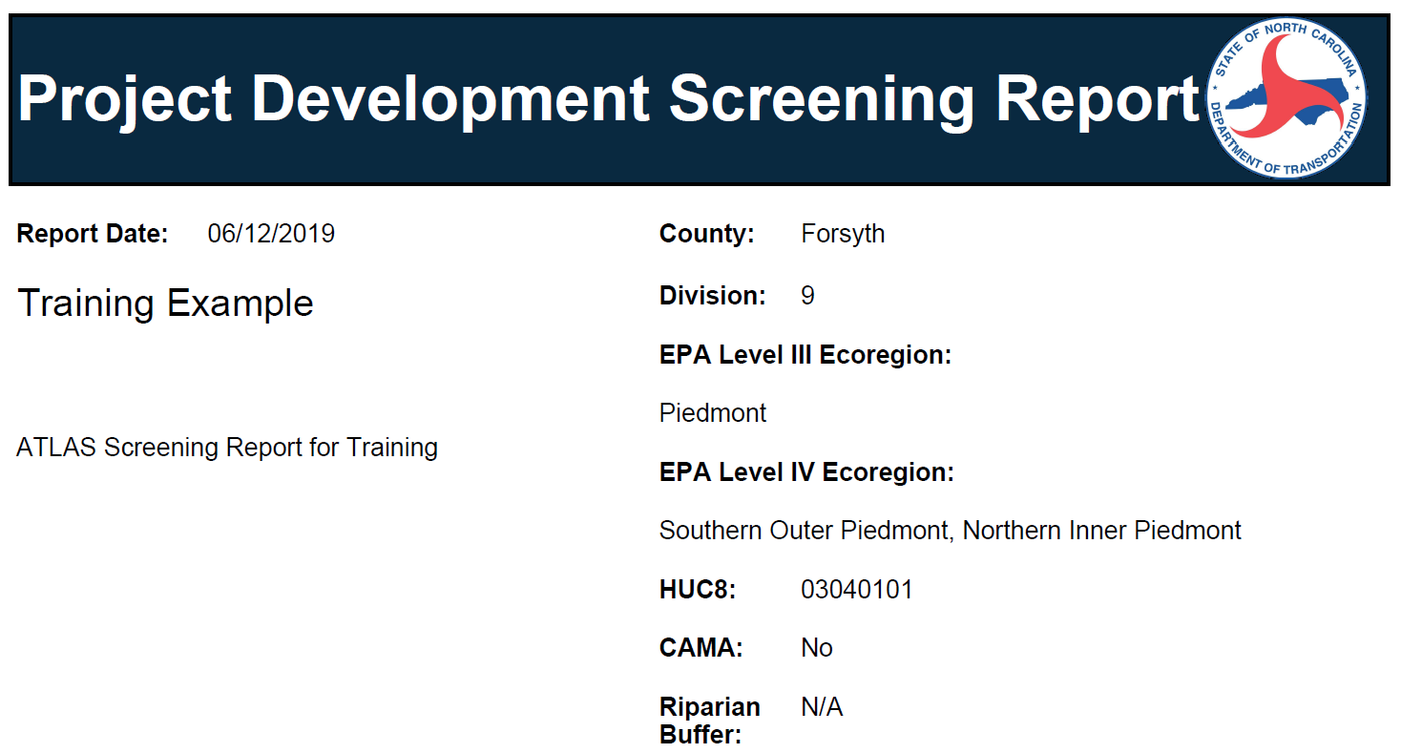
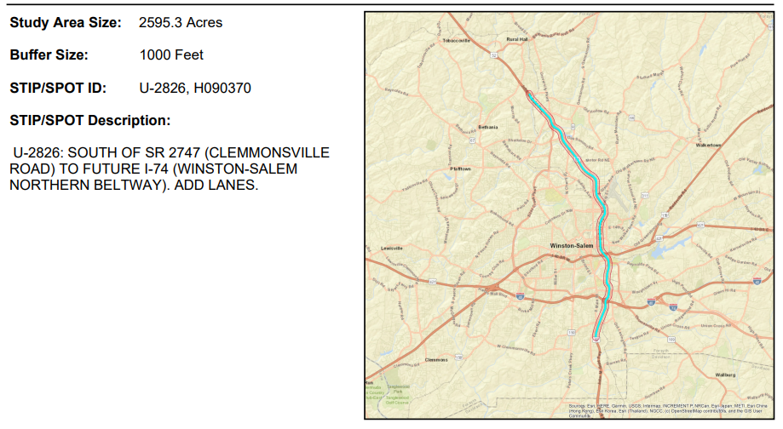
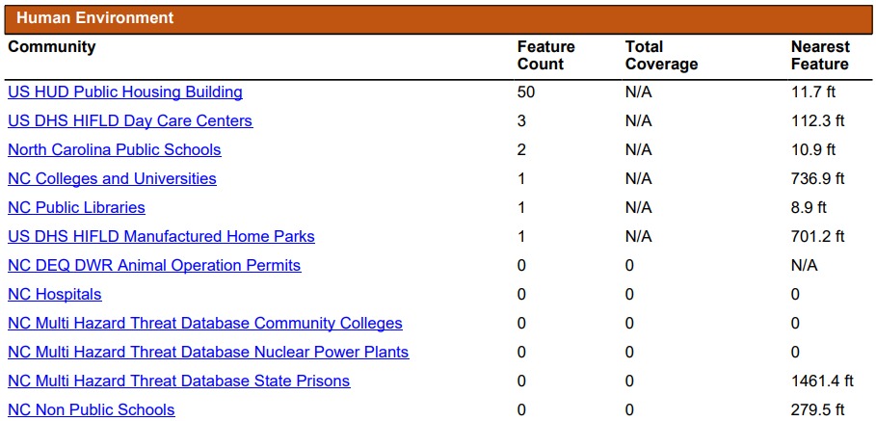
Project ATLAS: Improving Program Delivery at NCDOT
ATLAS Screening Tool

Slide 9
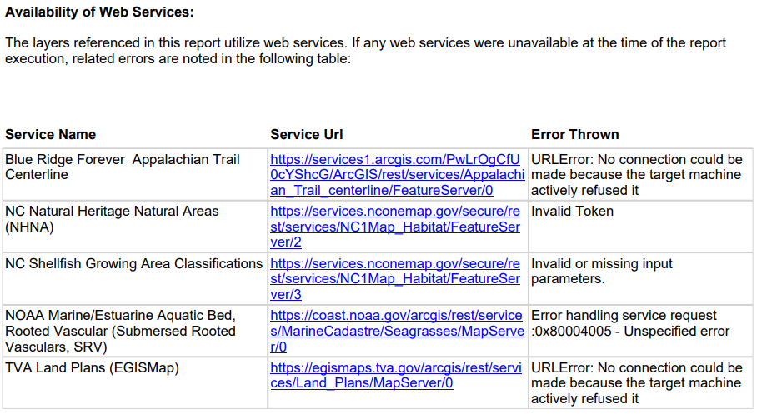
Project ATLAS: Improving Program Delivery at NCDOT
ATLAS Screening Tool

Slide 10
Project ATLAS: Improving Program Delivery at NCDOT
ATLAS Workbench
What the tool does for you:
Track project workflow
Ingestion of standard deliverable documents and spatial data
View your project within the context of surrounding projects and data for those projects
Automated report generation

Slide 11
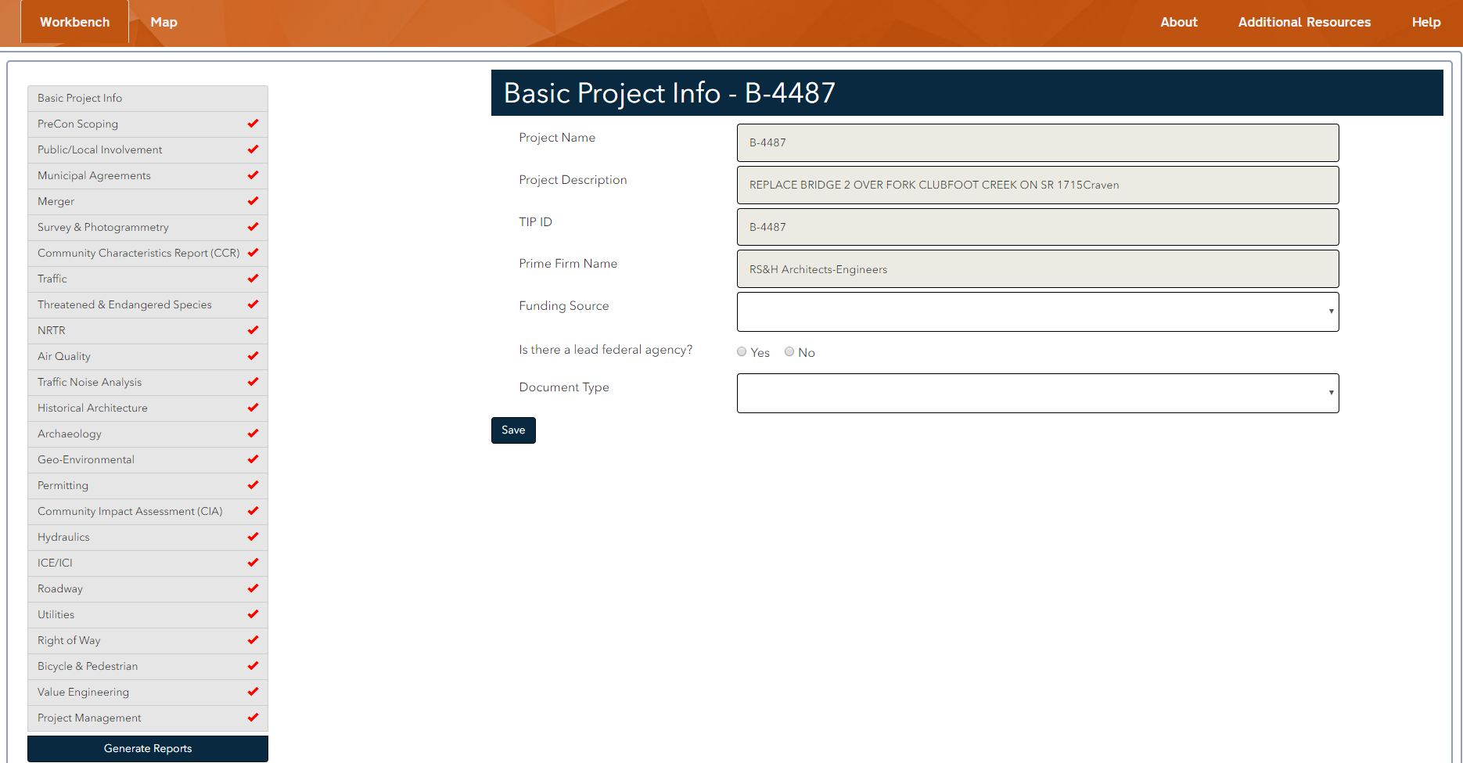
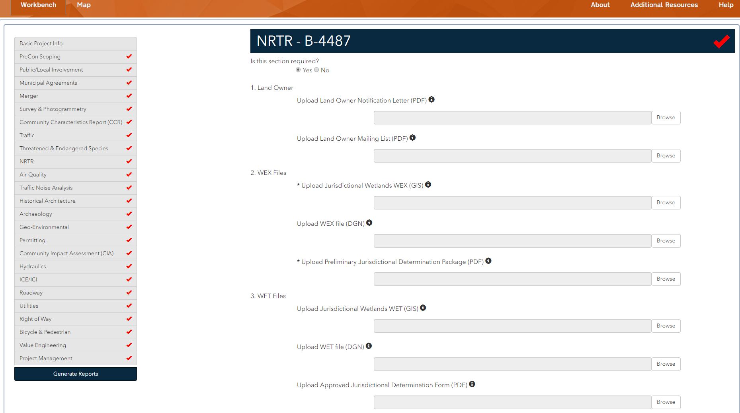
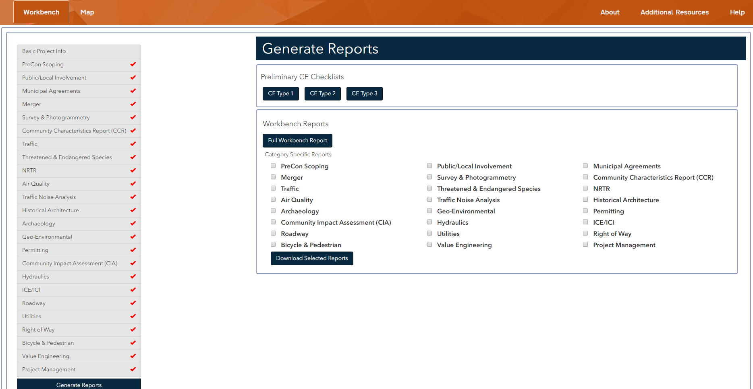
Project ATLAS: Improving Program Delivery at NCDOT
ATLAS Workbench

Slide 12
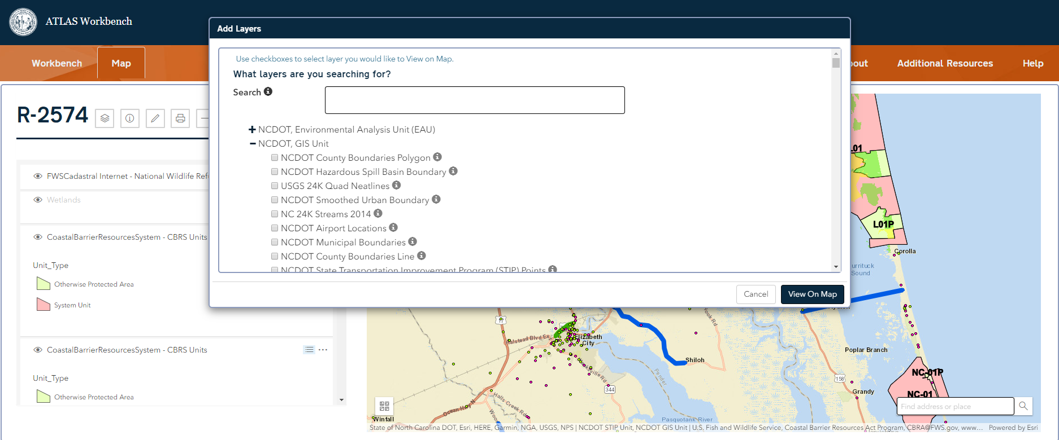
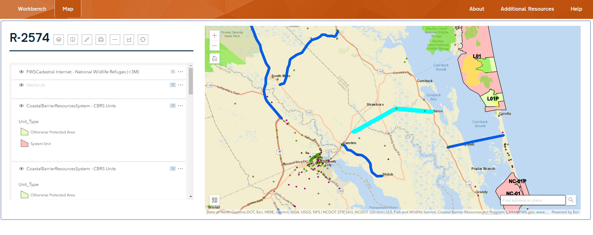
Project ATLAS: Improving Program Delivery at NCDOT
ATLAS Workbench

Slide 13
Project ATLAS: Improving Program Delivery at NCDOT
ATLAS: By the Numbers
June 2019
ATLAS Go-Live Date
Six releases since then
600+
100+
GIS Data Layers Available through ATLAS
Interviews with DOT Staff and Consultants as Part of Business Analysis Phase
40
ATLAS Training
Sessions
1-STOP SHOP
for Project Development
14
780+
200+
Divisions Represented at Training
ATLAS Training Attendees
Data Downloads
Run
4
900+
130+
ATLAS Live Webinars
Screenings Reports Run Since Go-Live
Brand-New GIS Layers Created by ATLAS Team

Slide 14
Project ATLAS: Improving Program Delivery at NCDOT
New Data Layers
October News Release - Community Studies, Historic Architecture and Archaeology,
Hydrography, Conservation Areas, Threatened and Endangered Species, Utilities (2 layers*)
Water Quality (4 layers*)
Hydrograph layer v1.2 – More robust coverage of headwaters along with 72 attributes that combined multiple datasets into one
Threatened and Endangered Species Data – IPAC, Models, NHP data in Screening
Utilities data – building data from multiple sources and owners
Major developments in Bike/Ped data
NCSU contract to advance community studies data

Slide 15
Project ATLAS: Improving Program Delivery at NCDOT
New Release This Week
Screening Tool Improvements
STIP geometry - part of download package
Set field – Ability to select more than one field, Indicator in report
Identify airports within 4 miles
Workbench Improvements
Worked with disciplines to improve Workflow content
View imagery in Workbench Map function
View attachments in Identify Dialog
Upload zip files and excel files
Launch to SharePoint project page from Workbench

Slide 16
Project ATLAS: Improving Program Delivery at NCDOT
Coming Releases
Search Tool Overhaul
Improved User Interface
Better search response
Ability to draw area of interest
Screening Tool Additions
Streams report
Endangered Species Report
Workbench
Discipline folders in SharePoint will have links to deliverables in ATLAS folder
Dependent questioning in Workflow

Slide 17
Project ATLAS: Improving Program Delivery at NCDOT
The Future of ATLAS …
More and more data development
Smoother handoffs between project phases and existing DOT investments/applications
Provide management-level views to track overall project development activity and guide funding/prioritization
Incorporate more business units
More map tools to put power of GIS into the hands of the non-GIS user
Enable regional and statewide screenings
More automation of standard reports/documents (PCRs, Project Commitments, etc.)
ATLAS Team
and much more…
Notes:
Just added 33 new layers outline in October news release
More interest from RPO/MPO to create connection and provide flow of data from long range planning to scoping to project development.
Tailored screening for specific business units such as geophysical.
Pulling in more workflows- Complete Streets data, Bike Ped data, Community Studies data development

Slide 18
Project ATLAS: Improving Program Delivery at NCDOT
A
T
L
A
S
Questions
And
Discussion
ATLAS@ncdot.gov

